Slide 1

Sales Analytics Dashboard
A Data-Driven Approach to Analyzing Coffee Sales, Product Trends, and Store Performance Using Excel
Nitin Bhagat

Slide 2
Business Problems
Track sales and order quantity by hour to identify peak business times.
Compare footfall and sales across multiple store locations.
Identify the most popular product categories and best-selling items.
Understand consumer order size preferences (e.g., Regular, Large, Small).
Determine sales performance by weekday to plan staffing and promotions.
Rank top 5 products based on total revenue.
Analyze how product category and size distribution affect overall sales.
Assess monthly trends to pinpoint high-sales periods.

Slide 3
Data Cleaning
Removed duplicates and null values.
Converted date and time into usable formats.
Added new columns for easier analysis:
Hour extracted from transaction time
Day Name and Month Name extracted from transaction date

Slide 4
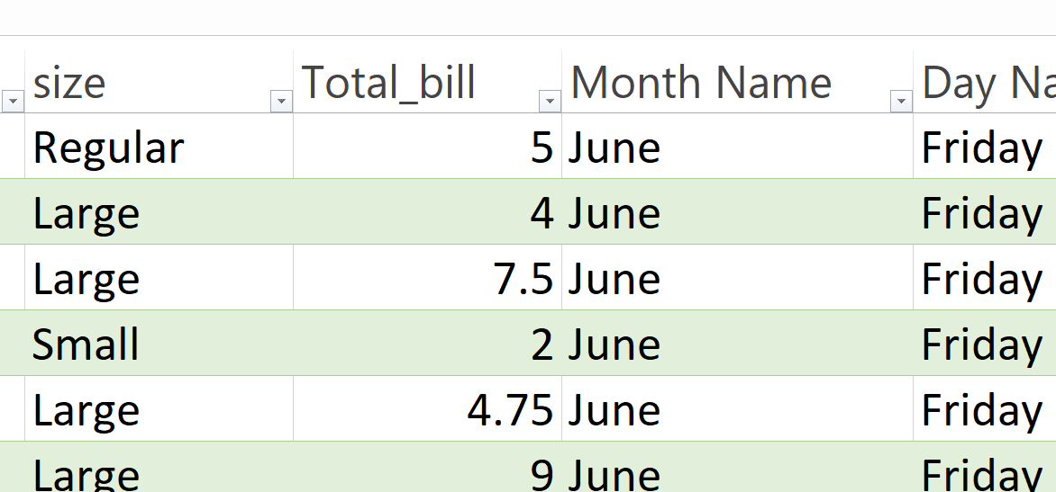

Data Processing
.
Enhanced dataset with calculated fields:
Total Bill = unit_price × transaction_qty
Time-based segmentation for hour-wise analysis
Store-wise breakdown to analyze regional performance

Slide 5
Data Analysis through Pivot Charts
In this step, we used Pivot Charts to analyze and visualize key trends:
Hourly Order Trend: Showed peak hours between 9 AM and 11 AM.
Category Distribution: Tea and Coffee dominate the sales mix.
Size-Based Sales Split: Regular and Large sizes are most preferred.
Top Products: Barista Espresso leads in revenue generation.
Weekday Analysis: Tuesday and Monday have the highest order volumes.
Store Comparison: Lower Manhattan generates the most revenue.

Slide 6
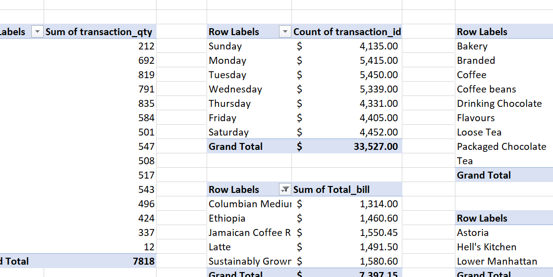
Data Analysis with PivotTables
Analyzed sales and quantities based on:
Hours
Weekdays
Store Locations
Product Categories
Product Size
Individual Product Names

Slide 7
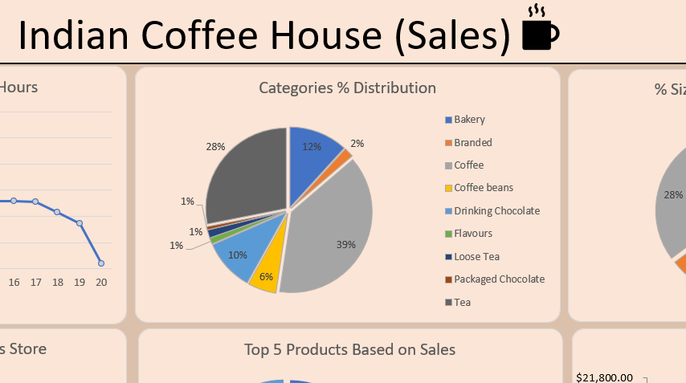
Initializing the Dashboard
Created an interactive Excel dashboard using:
Pivot Charts
Slicers for Month & Day
Conditional Formatting & Color Palette
Visual alignment and grouping for better readability

Slide 8
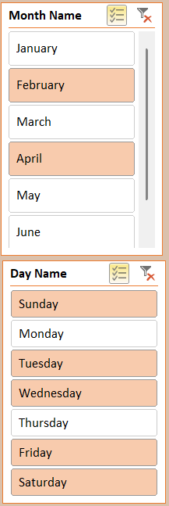
Slicers/Filters for Interactivity
Dynamic Slicers: Month and Day slicers for dynamic analysis
Real-Time Analysis: Enabled instant updates for data segmentation and insights.
Improved User Experience: Simplified data exploration and decision-making.

Slide 9
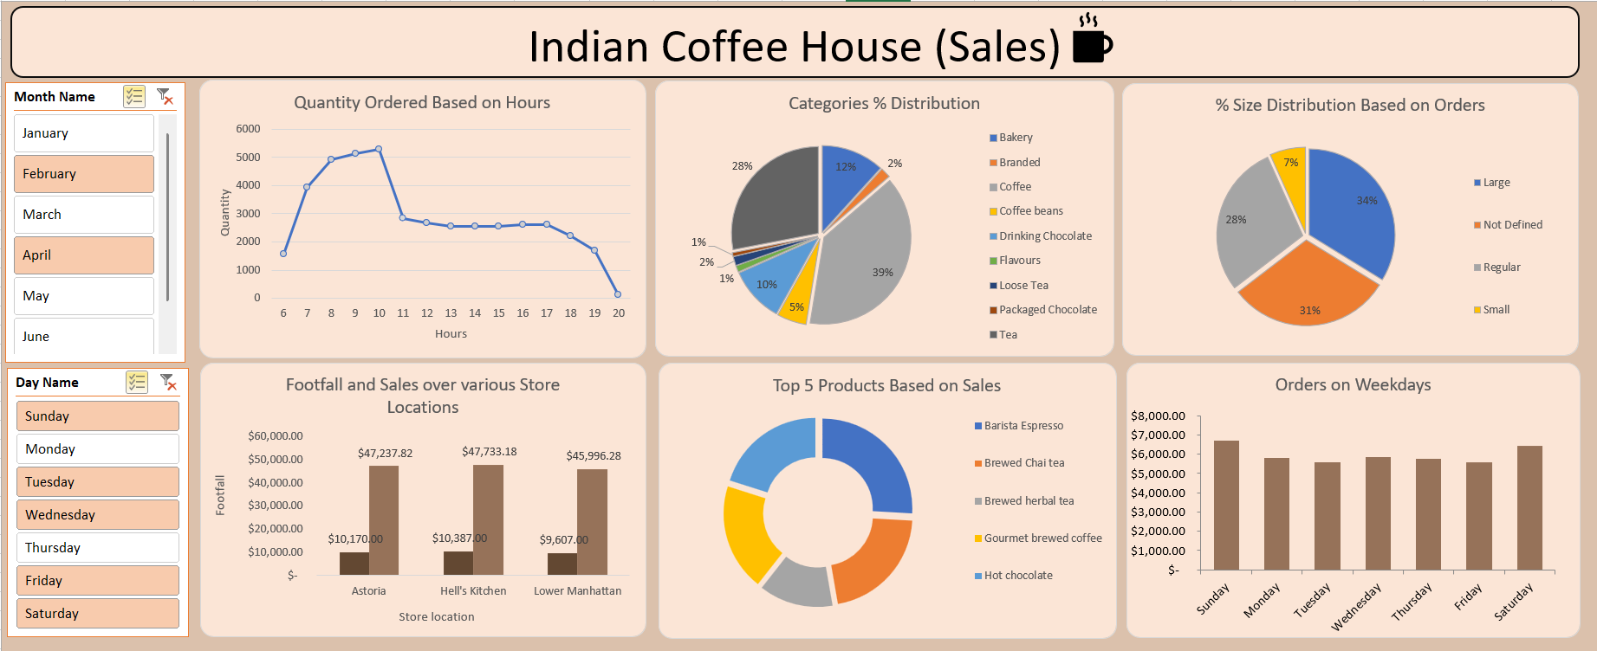
Interactive Dashboard Overview

Slide 10
Conclusion & Insights
Tea is the best-selling category, contributing 39% of sales.
Large and Regular order sizes dominate at 35% and 29%.
Lower Manhattan store contributes highest revenue ($8,410.31).
Tuesday and Monday are peak weekdays in terms of orders.
Barista Espresso is the top-selling product, generating $3,446.35 in revenue.
High customer footfall and revenue are observed during morning hours (9 AM – 11 AM).

